Slide 1
Big Mountain Ski Resort
Ticket price analysis

Slide 2
Problem Statement
How can Big mountain ski resort capitalize on all it’s facilities so they continue to make profits this year that will help offset the increased operating costs by $1,540,000 per season from additional lift chair by either selecting a better value for the ticket price or changing the hours of operation of resort so this investment strategy is not negatively impacted?
The Big mountain ski resort has so many facilities to offer than the other resorts of the same market segment
Goal: Identify which features can be capitalized

Slide 3
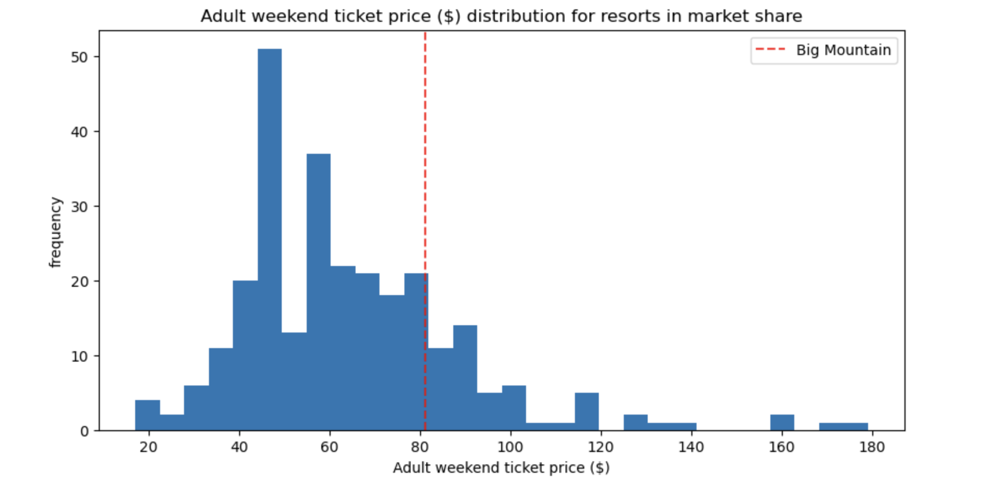
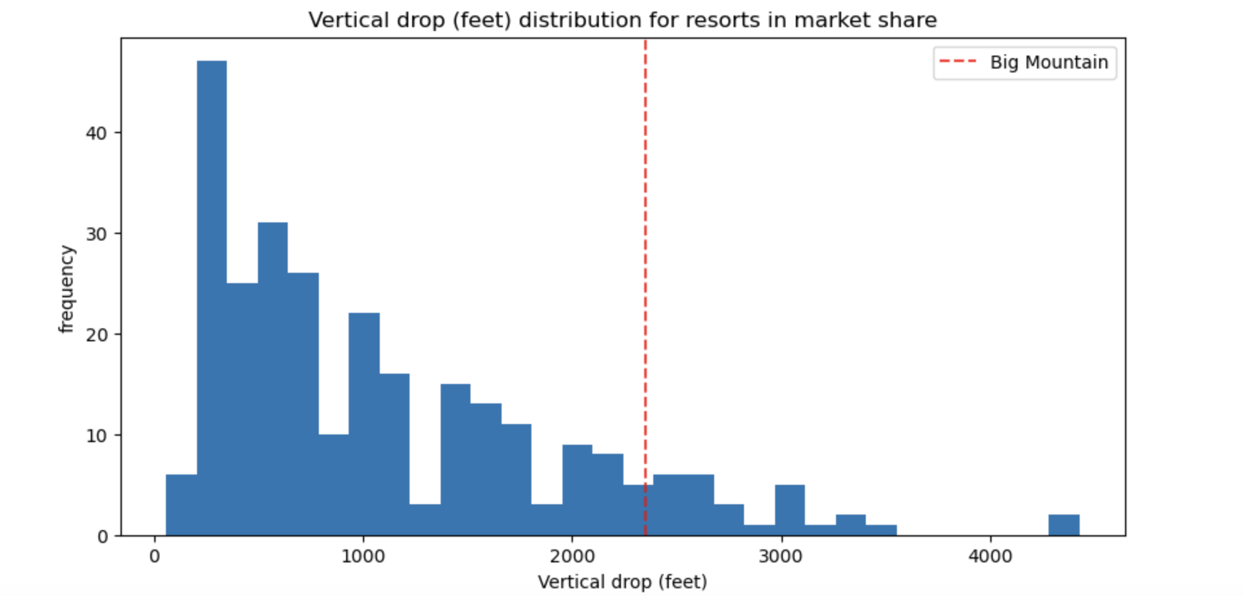
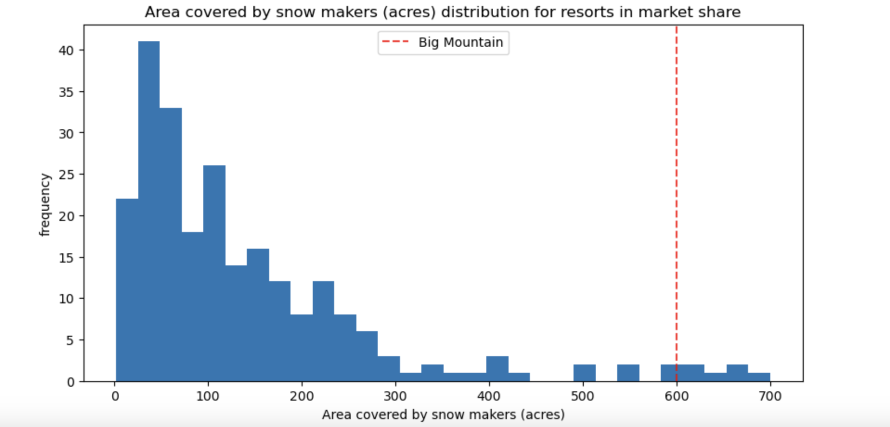
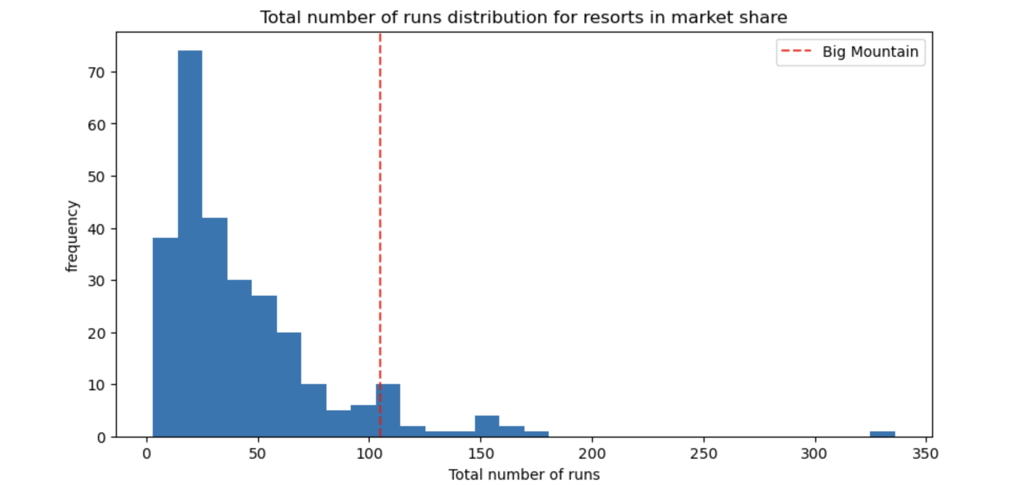
Modeling results and analysis
Adult weekend ticket price
Vertical drop distribution
Snow making distribution
Total runs by resorts distribution

Slide 4
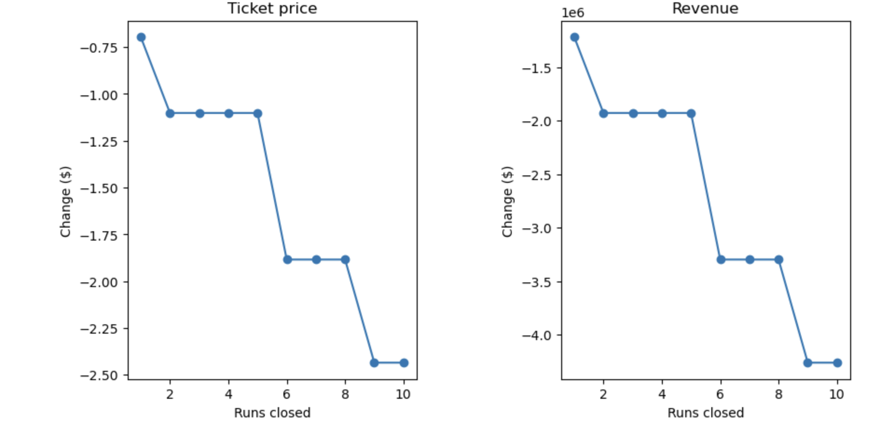
Scenarios suggested by business
Scenario 1 - Closing upto 10 runs
Scenario 4 - Adding 0.2 miles on the longest run
This scenario showed no difference/no impact on the price.

Slide 5
Scenarios suggested by business
Scenario 3 -
Increasing the vertical drop by adding a run to a point 150 feet
Increases the support for ticket price by $11.65 and over the season the expected amount would be close to $20.40M
Scenario 4 -
Increasing the vertical drop by adding a run to 150 feet and 2 acres of snow making.
Increases support for the ticket price by $13.71 and annually $23.99M

Slide 6
Recommendations & Key Findings
Key Findings:
Big Mountain Resort features was higher up in the league compared to other resorts for the features that the random forest model identified important.
From scenarios that business presented, scenario 1 & 4 didn’t have much impact on revenue.
Recommendations:
I would recommend the scenario 3 where the resort could add 150 feet drop and 2 acres of snow making that could help with the support for ticket price.

Slide 7
Summary & Conclusion
Big Mountain resort was well positioned for all the features which the random forest model identified has high importance.
Comparing the revenue and ticket price for each scenario displayed that scenario 1 and 4 were not as impactful and scenario 3 had an increase in the support for the ticket price
Knowing the operation costs for lifts would be a very helpful piece of the data. Other costs like maintenance, damage due to weather could also be good to consider in this project

